Slide 2

HEALTH RECORDS USING BLOCK CHAIN TECHNOLOGY
Blockchain technology is revolutionizing the way we manage and secure health records. By leveraging the decentralized, immutable nature of blockchain, healthcare organizations can enhance patient privacy, data integrity, and efficient data sharing.

Slide 3
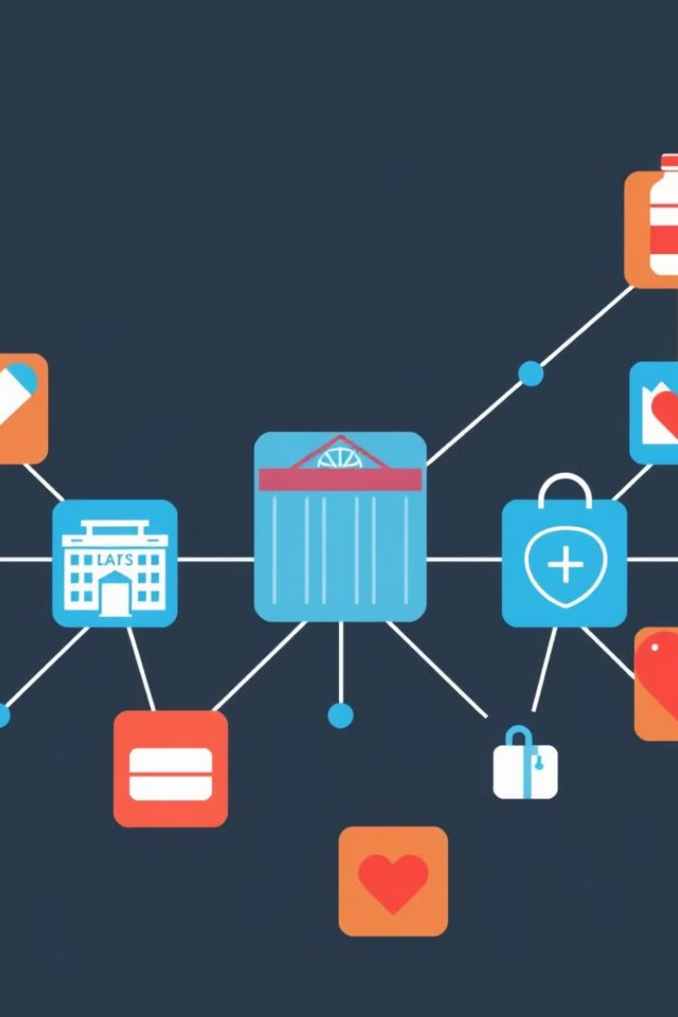
How Blockchain Works
1
Data Entry
Health data is recorded and encrypted into individual blocks on the blockchain.
2
Block Validation
The network of nodes verifies the validity of each new block through consensus mechanisms.
3
Secure Storage
The validated blocks are then added to the distributed ledger, creating an immutable record of health data.

Slide 4

Why Blockchain for Health Records
Improved Privacy
Data Integrity
Blockchain's decentralized nature and advanced cryptography enhance patient privacy by limiting unauthorized access to sensitive health data.
The immutable nature of the blockchain ensures that health records cannot be altered or tampered with, preserving data integrity.
Efficient Sharing
Cost Savings
Blockchain facilitates secure and seamless sharing of health data among authorized healthcare providers, improving care coordination.
Blockchain technology can reduce administrative costs associated with traditional health data management systems.

Slide 5
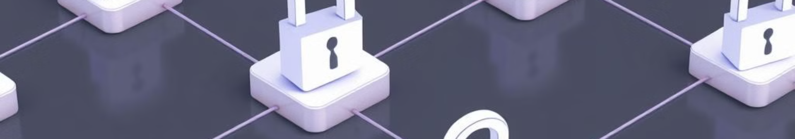
Blockchain Security for Health Records
1
Cryptographic Protection
2
Access Control
Blockchain utilizes advanced cryptographic techniques to secure health data, making it virtually impossible to tamper with.
Blockchain-based systems can implement granular access controls, allowing only authorized parties to view or modify health records.
3
Distributed Storage
4
Audit Trail
By storing health data across a decentralized network, blockchain reduces the risk of a single point of failure or data breach.
The immutable ledger of the blockchain provides a transparent audit trail, enabling healthcare organizations to track all data modifications.

Slide 6
Benefits of Blockchain in Health Records
Improved Patient Outcomes
Enhanced Data Transparency
Cost Reduction
Blockchain's automation and streamlining of administrative processes can lead to significant cost savings for healthcare providers.
Secure and seamless data sharing enabled by blockchain can lead to better-informed clinical decisions and improved patient care.
The immutable nature of blockchain provides healthcare organizations with a transparent view of all data transactions and changes.

Slide 7





Blockchain Use Cases in Healthcare
Electronic Health Records
Clinical Trials
Secure and tamper-resistant storage of patient medical history and data.
Streamlined patient recruitment, data collection, and results reporting.
Supply Chain
Insurance Claims
Improved visibility and traceability of pharmaceutical and medical device supply chains.
Automated and tamper-proof processing of insurance claims and payments.

Slide 8
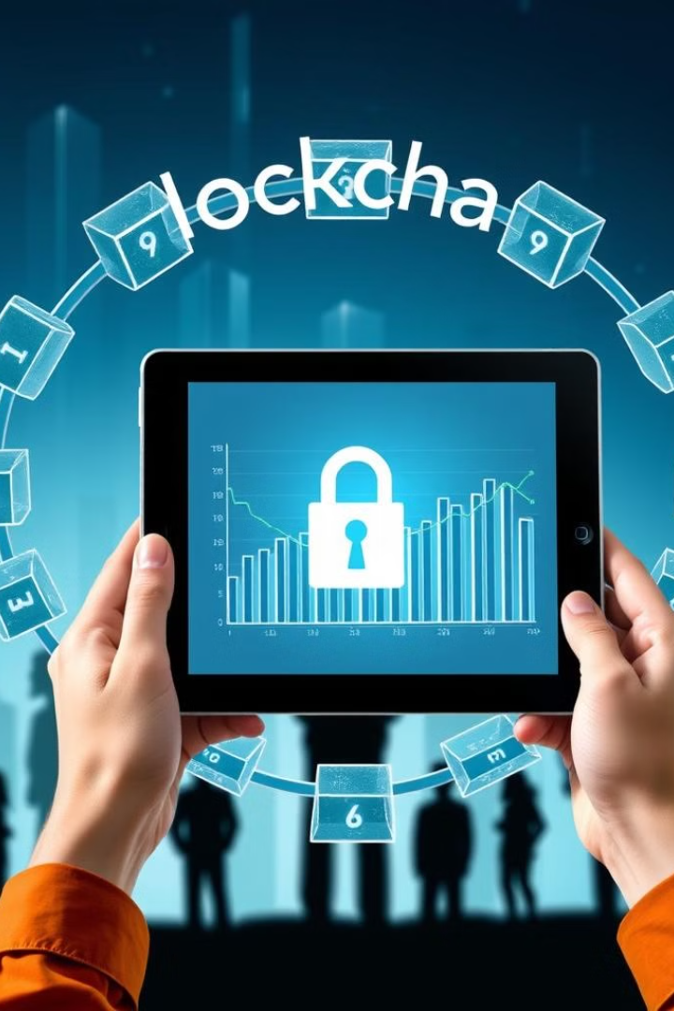



Patient Privacy and Data Integrity
Encryption
Health data is encrypted before being added to the blockchain, ensuring privacy.
Access Control
Granular access permissions allow only authorized parties to view or modify records.
Immutable Ledger
The blockchain's distributed ledger prevents any unauthorized changes to patient data.

Slide 9
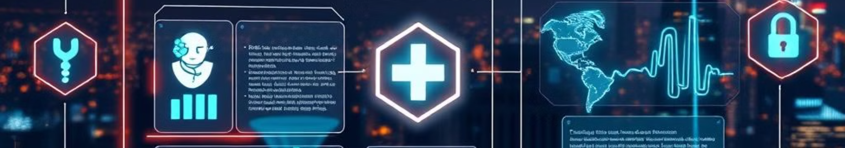
Future Trends and Opportunities
1
Interoperability
2
Patient-Centric Care
Blockchain-based systems will enable seamless data exchange between healthcare providers, improving care coordination.
Patients will have greater control and ownership over their health data, empowering them to make more informed decisions.
3
Artificial Intelligence
4
Decentralized Clinical Trials
The integration of blockchain and AI will unlock new possibilities for predictive analytics and personalized medicine.
Blockchain will facilitate the decentralization of clinical trials, making them more accessible and efficient.

Slide 10

FINALLY OUR PROJECT PRESENTATION

